Slide 2
Make Games with .NET using Visual Studio, Unity, and PlayFab
Jb Evain and John Miller

Slide 3
Unity

Slide 4

Unity
Unity is the
most widely used real-time 3D development platform.
Other

Slide 5






























Target and Optimize Content for 25+ Platforms
Notes:
Unity works on 25+ platforms, giving developers the power to target and optimize their content and reach the widest possible audience Including Windows, Universal Windows Platform, Mac OS, Linux, iOS, tvOS, Android (ARM & Intel X86), Android TV, FireOS, Xbox One, PlayStation 4, PlayStation Vita, Wii U, 3DS, Switch, WebGL, Gameroom (Facebook), SteamVR (PC & Mac), Oculus, PSVR, Gear VR, Cardboard (Android, iOS), Daydream, Windows Mixed Reality, HoloLens, ARKit (Apple), ARCore (Google), Vuforia and Xiaomi.

Slide 6
Scripting Games with Unity
.NET and C#
Visual Studio ecosystem

Slide 7
Get started
https://unity3d.com
https://unity3d.com/learn

Slide 8
Getting started with Unity

Slide 9
Visual Studio Tools for Unity

Slide 10
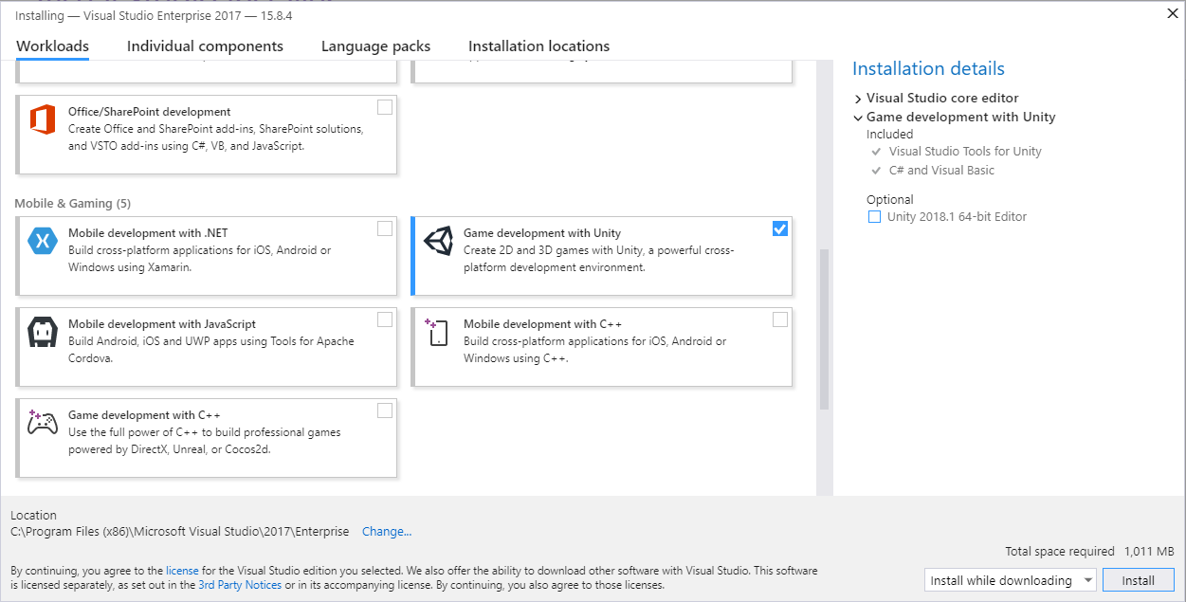
Getting Started
Game Development with Unity workload
Included in Visual Studio for Mac

Slide 11
Features
Write and debug your Unity games
Unity productivity helpers
Documentation
Smart projects reload
Solution Explorer
IntelliSense
MonoBehaviour Wizard

Slide 12
Unity and Visual Studio

Slide 13
What’s new in Unity For .NET developers

Slide 14
Mono Update
Bug fixes and performance
Debugging improvements
API profiles
.NET 4.7
.NET Standard 2.0
C# 7 and Roslyn

Slide 15
Connected Games

Slide 16

Notes:
A backend platform for live games.

Slide 17
Game Services
Player management
Multiplayer
Commerce
Leaderboards

Slide 18
Real-time Analytics
Dashboards
A/B testing
Reports

Slide 19
Live-ops
Email messaging
Content updates
In-game events

Slide 20
Dynamically configuring games

Slide 21
Title Data
Key/value storage
Configuration data

Slide 22
Learn more
https://playfab.com/features

Slide 23
Thank you!

